Slide 1
L6-SNA
Musica Supriya

Slide 2
Centralization
It is an important way to understand the role of node in the networks and to compare the nodes
Centrality measure is used to understand the network
What does high centrality mean?
How do we compute it?

Slide 3


n* is the most central node and ni is every other node

Slide 4
Small world
Six degrees of separation
The Kevin Bacon Game
Milgram’s experiment

Slide 5
Small world
Short average shortest path length
High clustering(measured by local clustering coefficient)

Slide 6
Regular Network
Calculate the density for ego nodes A, B

Slide 7
Random Network
Calculate the density for ego nodes A, B

Slide 8
In 2011, Facebook had 720 million users and the average shortest path length was 4.74
How is this possible?

Slide 9
Why increase randomness of the network?

Slide 10
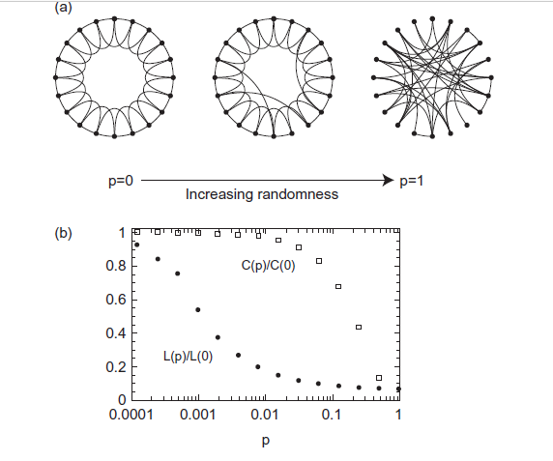
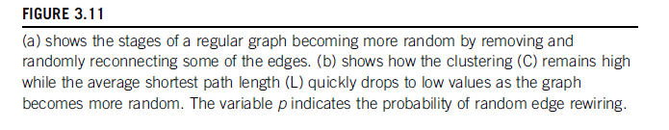

Slide 11
